Slide 1

Synch S1
Anthony, Taylor, Ki, Kennedy, Katie, Joon
Notes:
katie

Slide 2
What We Have to Offer
Fusion of:
Wireless AI technology
Predictive Analytics
Enhanced Safety features
User Centered Design
The Synch 1 will:
Be Autonomous
Be Electric
Have wireless charging capabilities
Have phone applications to interact with the car
GPS Tracking, Route Generation, and Traffic Analysis
Notes:
katie

Slide 3
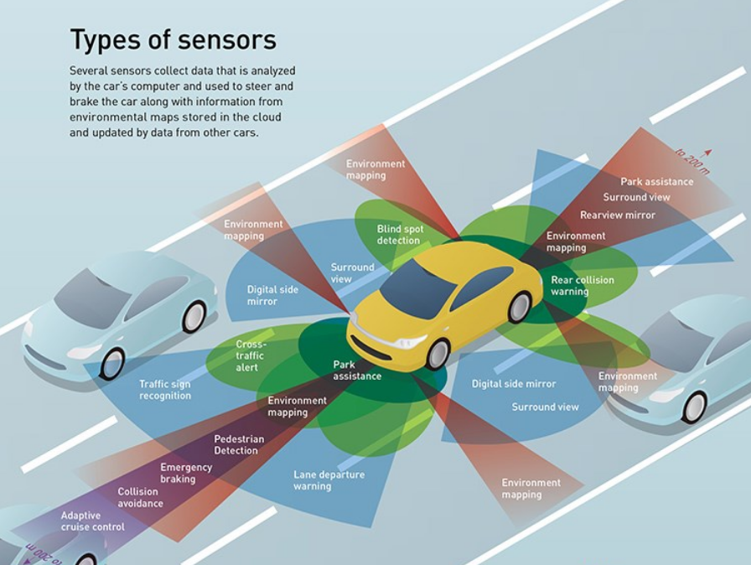
Notes:
joon

Slide 4
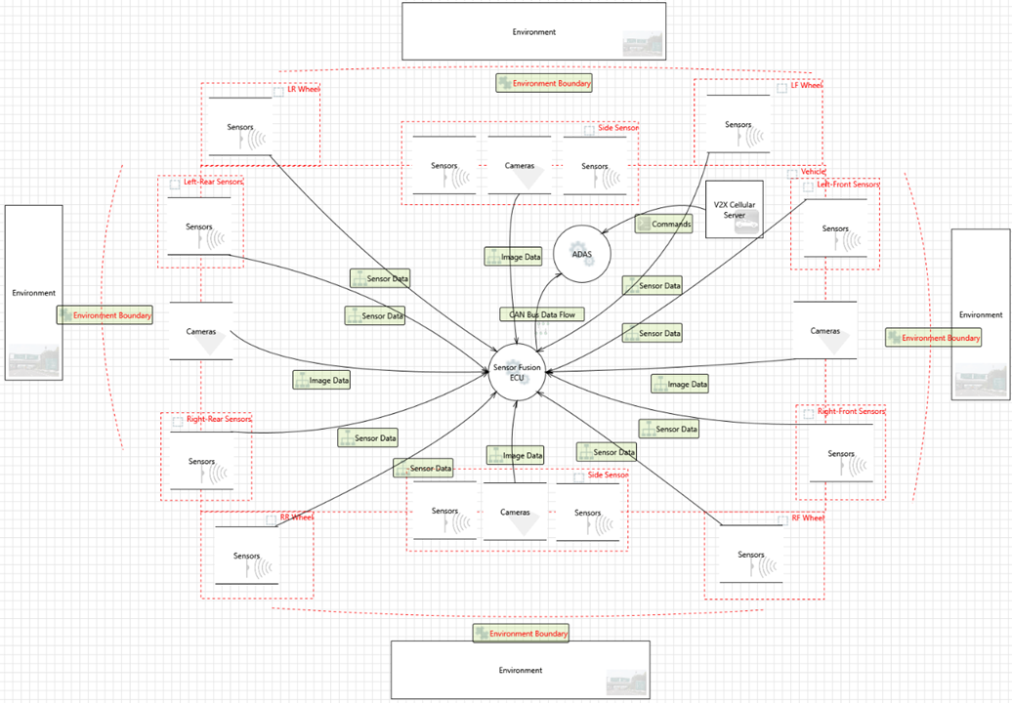
Notes:
joon

Slide 5
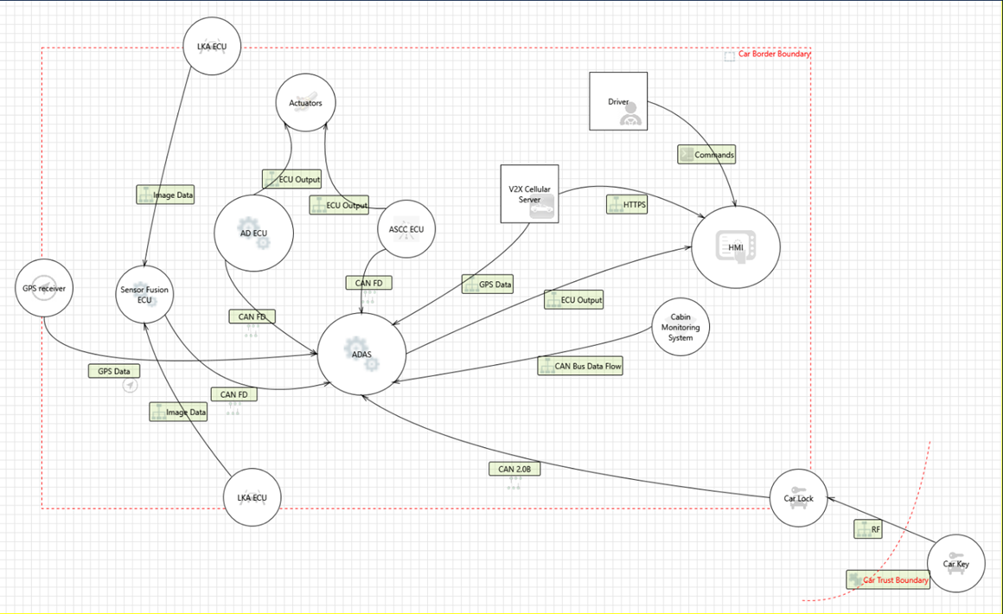
Notes:
joon

Slide 6
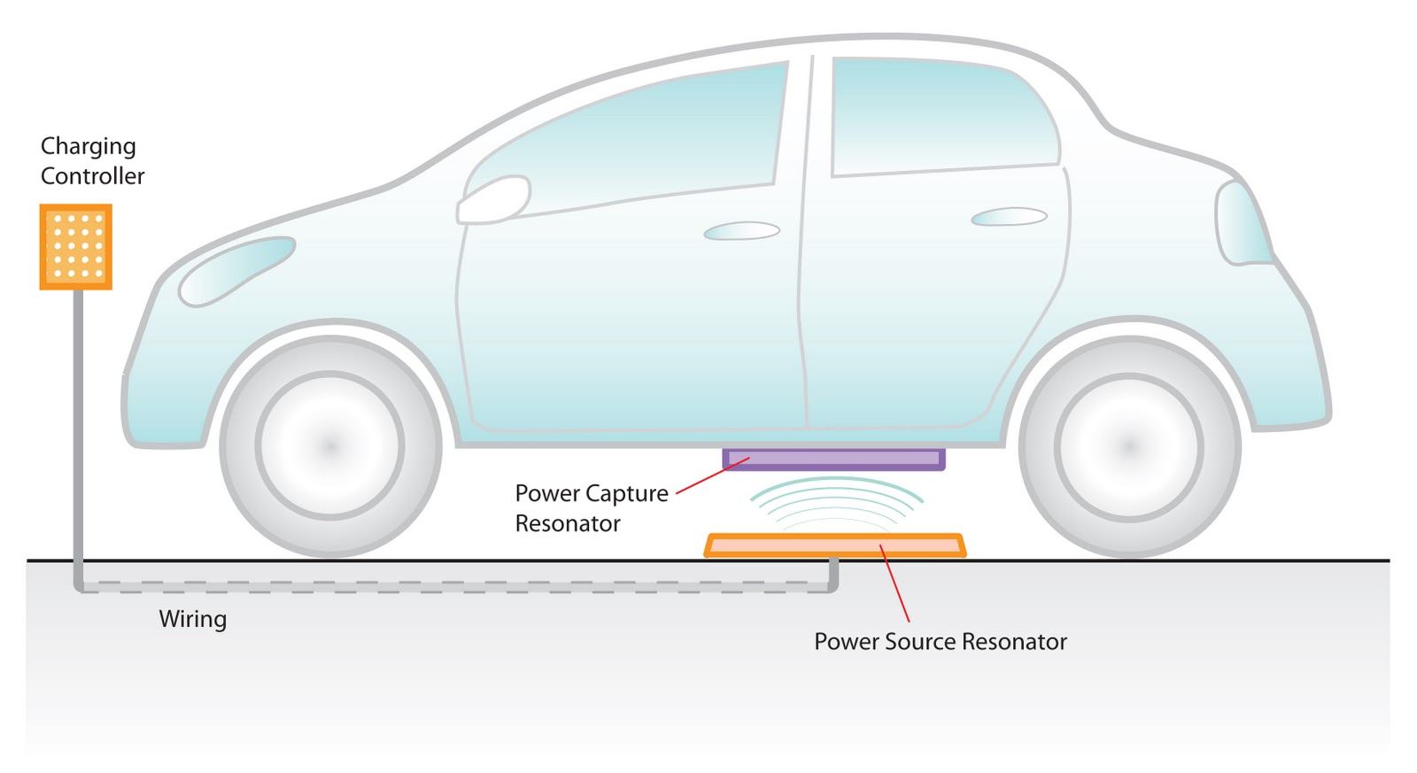
Wireless Charging
Control Panel – Supplies power to the Parking Pad & Displays charge status
Inductive Pad – Transmits electromagnetic energy to vehicle’s resonator
Power Capture Resonator / Adapter – Receives and converts energy from inductive pad.
Notes:
kennedy

Slide 7
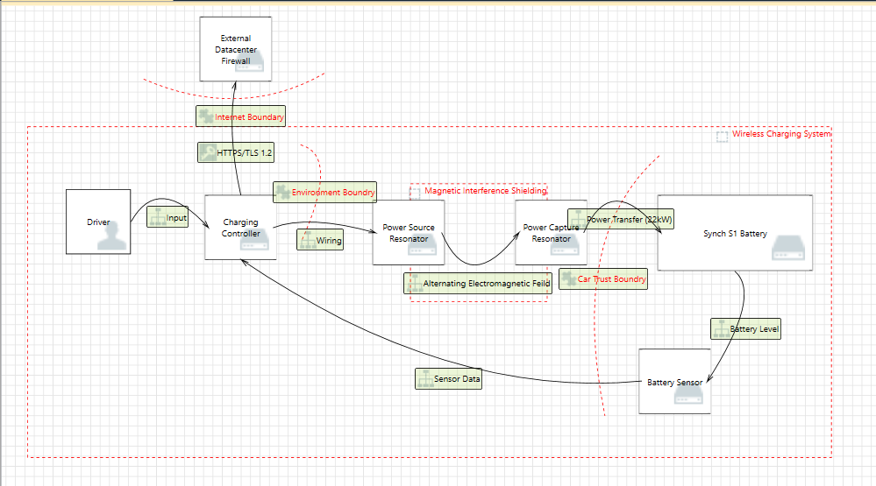
Notes:
Kennedy
Qualcomm Halo Technologies:
- Can transfer power at up to 22kW
- 80 miles of range per hour
- approx. 1.5 hrs to full charge (90% efficiency).

Slide 8
Phone Applications
Car for Hire
Chauffer Mode
Owners can "lease" their car during times that they are not driving it (such as late at night), and the car will pick up rideshare passengers to bring them to their destinations (self-driving)
This will allow the owner to earn money when they are not driving
Car would have a Chauffeur Mode that would allow owner to send the car out to pick someone up​
Person being picked up would have to verify their identity via a one-time code sent to their phone (as well as other forms of verification that the user could combine to increase security)​
Could be set on a schedule to automate regular pickups
Notes:
katie

Slide 9
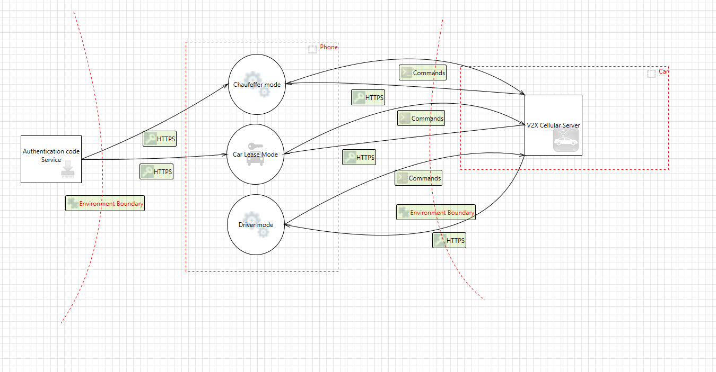
Phone Applications
Notes:
anthony

Slide 10
Traffic route analysis/ Road Trip Mode
Predictive route analytics for traffic and routing for dynamic movement
Passing this vehicle traffic information will increase safety conditions for the passengers around the vehicle.
It will also be able to find most efficient route for passengers to travel
Car would be able to plan long trips where riders could sleep and relax while car navigates to destination overnight
Would be able to recharge on its own, could set "stops" along the way
Imagine going to bed in Seattle and waking up at the Grand Canyon
Notes:
katie

Slide 11
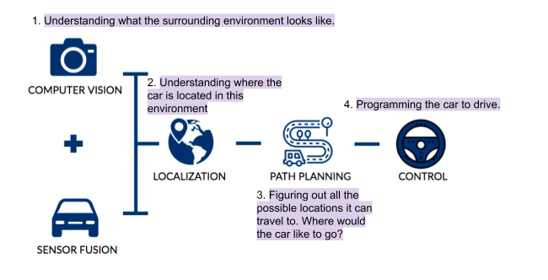
GPS Tracking, Route Generation, and Traffic Analysis
Notes:
ki

Slide 12
GPS Tracking, Route Generation, and Traffic Analysis
Computer Vision: Camera images to find lanes, lines, road signs, traffic signs, or to track other vehicles on the road.
Sensor Fusion: Integrate data from the camera images and the sensors to build a comprehensive understanding of the vehicle's environment. After this stage, the vehicle knows what the outside environment looks like.
Localization: After the vehicle knows the environment, it needs to figure out the vehicle's location. The vehicle is using GPS technology.
Path Planning: The AI calculates the best route based on the traffic, the weather, and the sensor fusion data.
Control: Using a series of algorithms, the vehicle drives itself.
Notes:
ki

Slide 13
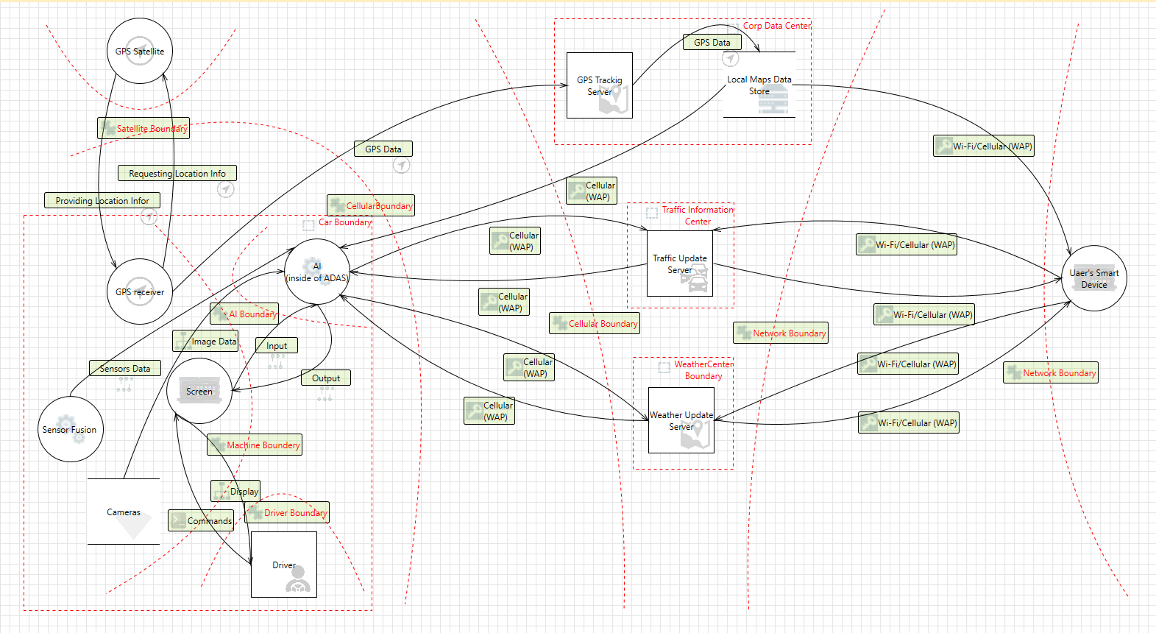
Notes:
ki

Slide 14
Infrastructure
Datacenter/HQ/Manufacturing: Seattle, WA
Datacenter Design Goals
Allow customers, employees, and the rest of our infrastructure efficient, reliable and secure access to our services.
Only use backup/standby appliances where necessary (single points of failure) in order to reduce overhead cost
Minimize the number of appliances to conserve floor/rack space and maintenance
Notes:
taylor

Slide 15
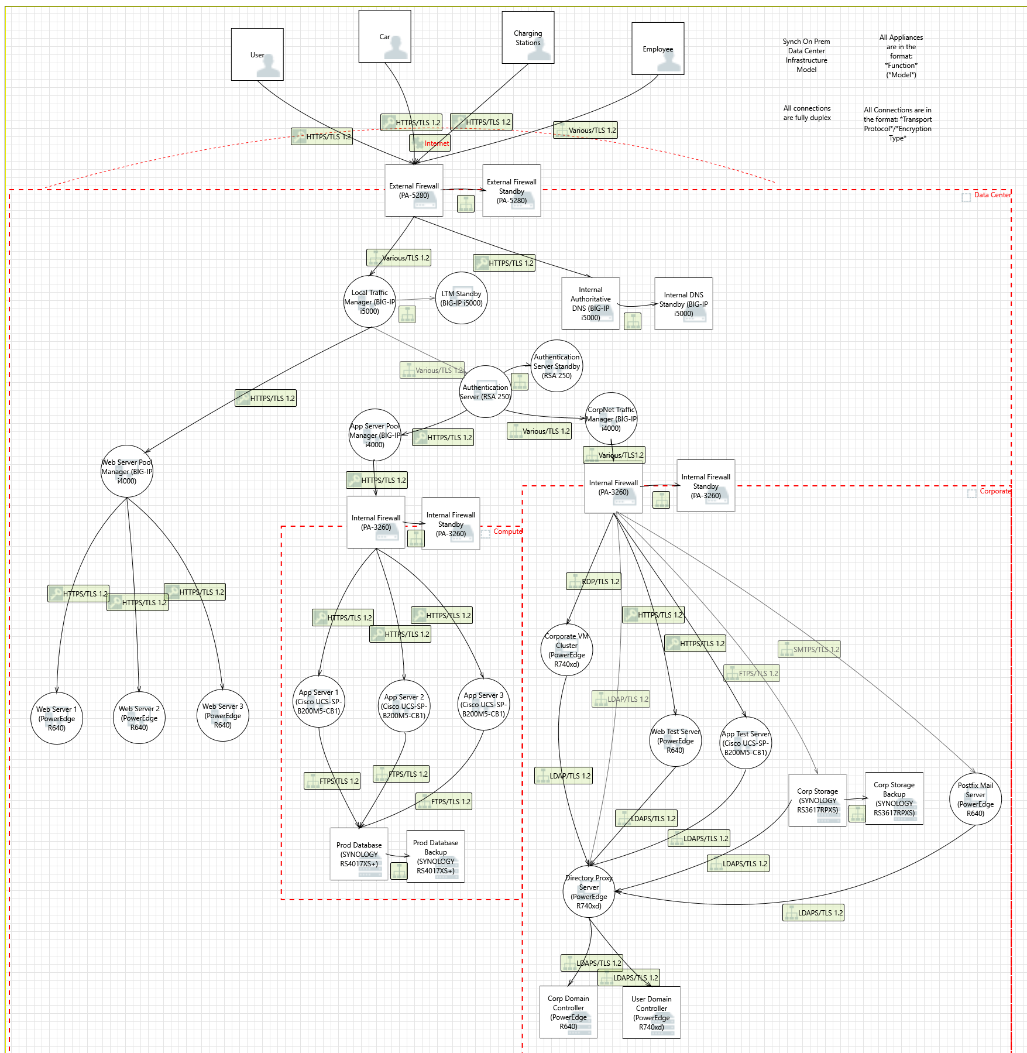
Data Center Infrastructure Model
Notes:
taylor

Slide 16
Infrastructure Protection
Spoofing – AD/RSA Authentication
Tampering – TLS 1.2 in transit, AES-256 at rest
Repudiation – RAID 1 log backup
Information Disclosure – Minimum connections
DOS – Standbys, next-gen firewalls, internal DNS
Elevation of privilege – Trust boundaries/firewalls
Notes:
taylor

Slide 17
Thank You! Any Questions??

